Slide 1
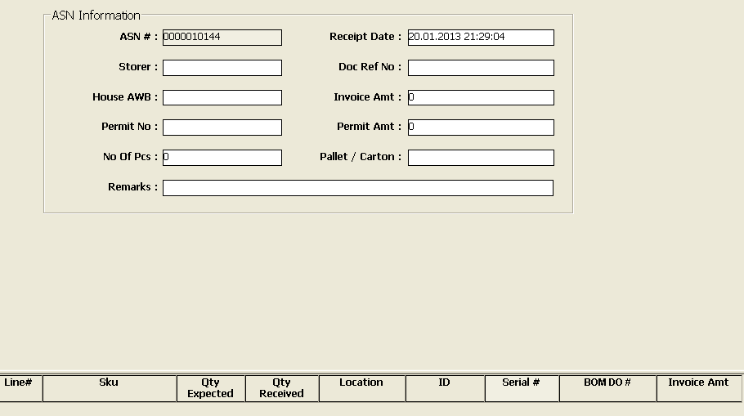

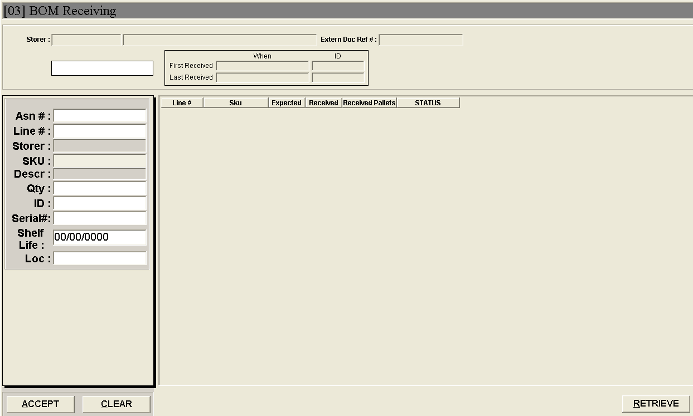
Inbound
Engage / Mirror the existing Inbound receiving function into the new hub.
Importing of customer SKU file into hub for validation. Should be done easily by super users.
Insertion of shipment received date.
Entries of details in receiving to be generated in reports
To be able to generate history of receipts based on several fields entries such as STO#, DO#, MAWB, HAWB and ASN#
Considering on importing of receiving files

Slide 2
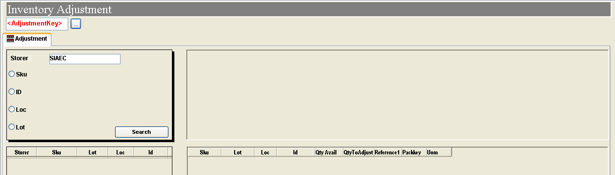
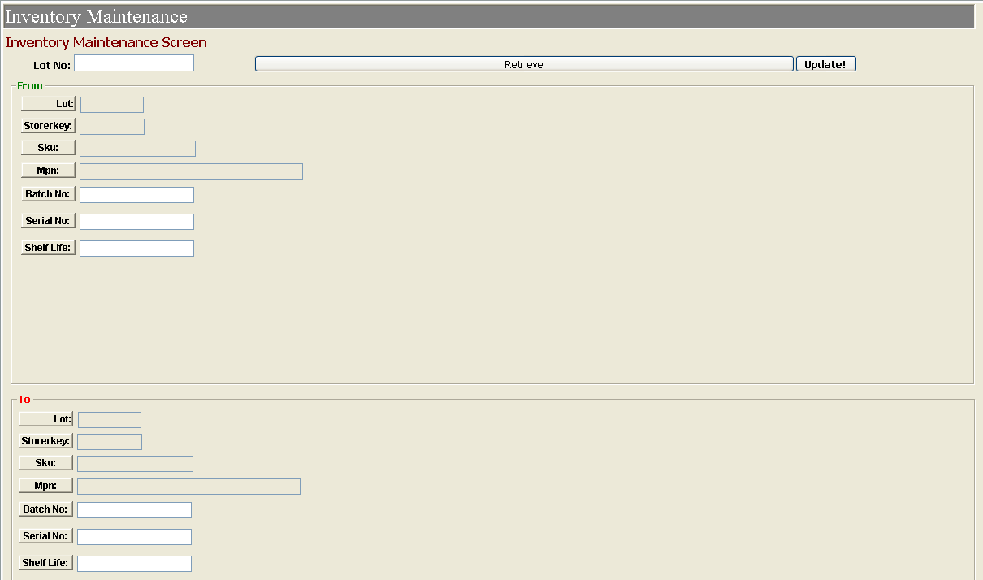
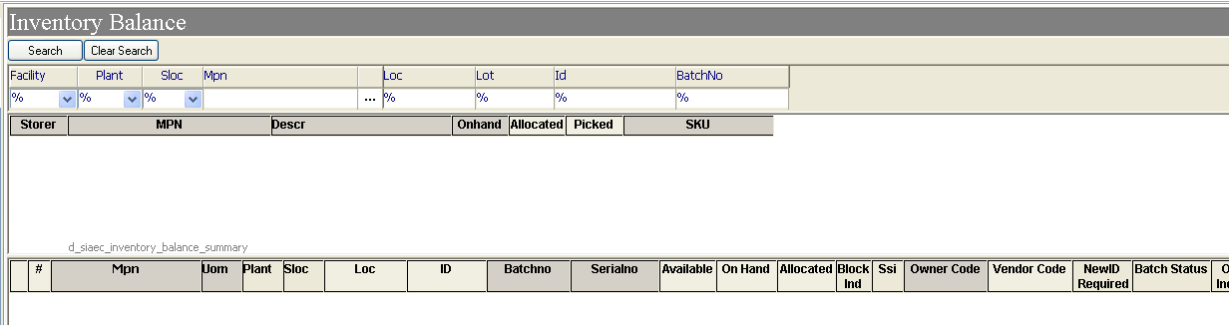
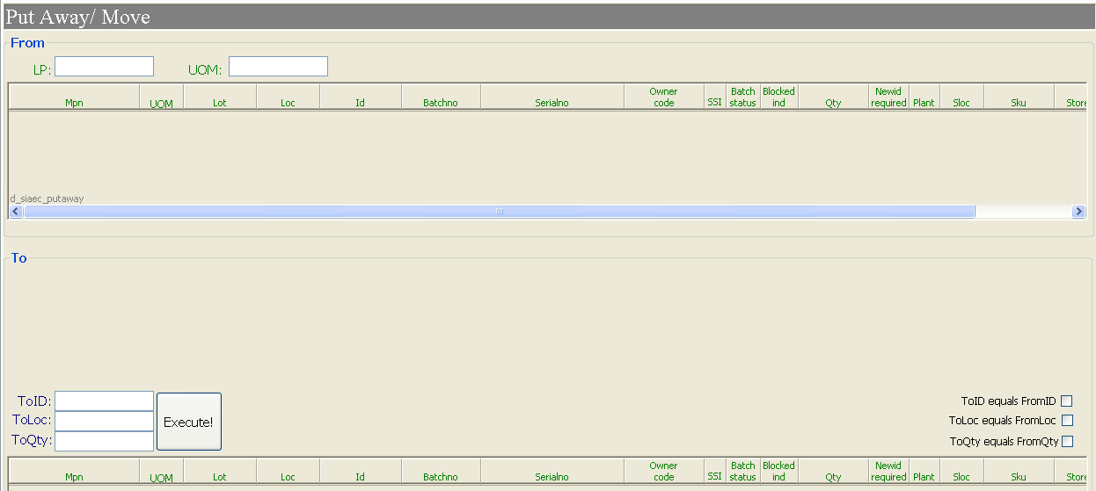
Inventory Management
Inventory adjustment function to be available in new hub.
Enhancing on the current inventory balance search function.
Inventory maintenance to be added in new hub. (only for super users)
Putaway / Move function to be included in new hub

Slide 3
Outbound
Order Creation screen to be enhance with more input fields. Such as cargo details, service level and also enable Ops to allocate stock via LP level. Creator ID to be reflected on the printing too.
Print Pick list function to be enhanced.
Print DN function to be enhanced.
Output of the prints are to be improved thru more inputs from order creation.
Replace manual rubber stamping of service level and member’s name who processed shipment.
Order Processing screen function to alter changes and to perform ship-out.

Slide 4
Reports
Incoming report to contain all incoming records with item details.
Incoming KPI report
Shelf-life monitoring report
Storage Bin availability report
Inventory report
Generate Cycle Count report for items issued within a week.
Outbound KPI report

Slide 5
